Slide 1


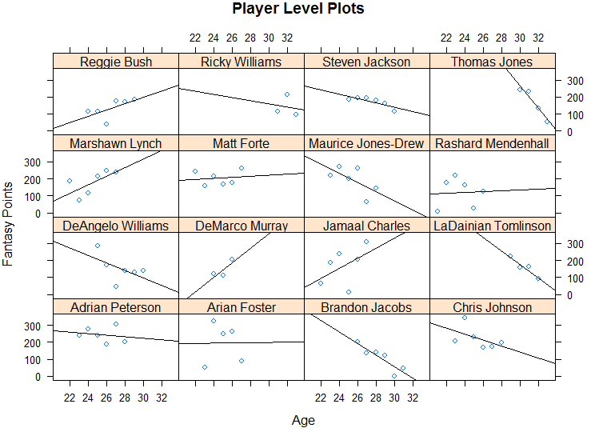
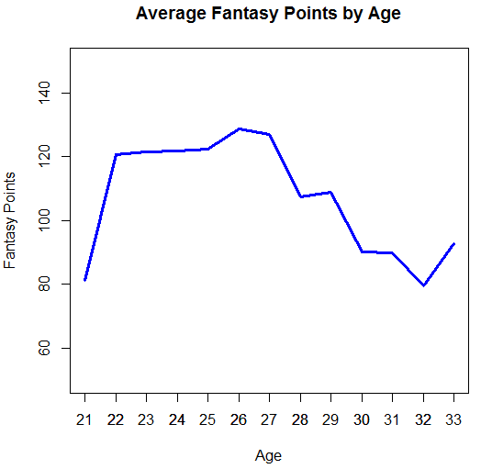
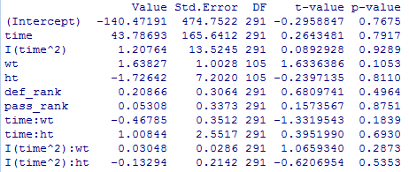
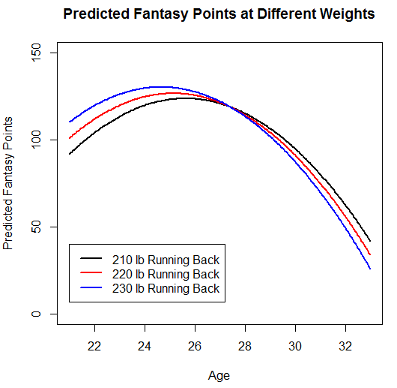


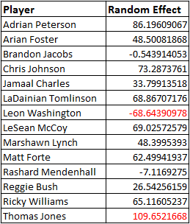

When Do NFL Running Backs Peak?
Bogdan Gadidov and John Michael Croft
Advising Faculty: Dr. Brad Barney
Department of Statistics and Analytical Sciences
  Abstract
  Exploratory Plots
  Conclusions
Fantasy points from NFL running backs were used to find the age at which player production peaks. Data was collected for 70 NFL running backs from the years 2008 to 2013. Individual player statistics such as rush attempts, receptions, height, weight, and age were collected, as well as team statistics such as defensive rank and offensive rank. Time was modeled quadratically using a random intercepts model. Our analysis suggests running backs peak around ages 24-26.
Running backs’ production peaks between ages 24 to 26. Heavy running backs peak earlier with the highest production; however, running backs are more productive later in their career. Between the ages of 26 to 28 , there appears to be very little difference in production between different weight classes.
  R Code
In the Player Level Plots graph above, there are 16 individual level plots for various players. Some features that are apparent are that the older running backs’ (Thomas Jones, LaDainian Tomlinson, Brandon Jacobs) performances are declining, while the younger running backs’ (Jamaal Charles, DeMarco Murray, Matt Forte) performances are increasing.
In the Average Fantasy Points by Age plot on the right, the average fantasy points is plotted for each age group. The peak occurs at ages 26 and 27.
csh <-gls(fantasy~time+I(time^2)+def_rank+pass_rank+ht+wt+
time:ht+time:wt+
I(time^2):ht+I(time^2):wt,
correlation=corCompSymm(form=~time|player),
weights=varIdent(form=~1|as.factor(time)),
data=rbdata)
RI2<- lme(fantasy~time+I(time^2)+wt+ht+def_rank+pass_rank+
time:wt+time:ht
+I(time^2):wt+I(time^2):ht,
weights=varIdent(form=~1|time),
data=rbdata, random=~1|player, na.action=na.omit)
anova(RI2,csh)
RI4<- lme(fantasy~time+I(time^2)+wt+
time:wt,
weights=varIdent(form=~1|time),
data=rbdata, random=~1|player, na.action=na.omit)
# average pts by age plot
plot(0,0, xlim=c(21,33), ylim=c(50,150), type="n", main="Average Fantasy Points by Age",
xlab="Age", ylab="Fantasy Points")
lines(mean_fantasy$Group.1,mean_fantasy$x,lwd=3,col="blue")
axis(1,at=c(21:33))
tp <- seq(0,12,by=.05)
y210 <- -102.16174 + 44.06613*tp -1.50111*tp^2 +.92349*210 - .14386*210*tp
y220 <- -102.16174 + 44.06613*tp -1.50111*tp^2 +.92349*220 - .14386*220*tp
y230 <- -102.16174 + 44.06613*tp -1.50111*tp^2 +.92349*230 - .14386*230*tp
# plot of players
xyplot(fantasy~age|player, data=rbdata[rbdata$player %in%
c("Adrian Peterson", "Arian Foster", "Marshawn Lynch", "DeMarco Murray", "Jamaal Charles",
"Maurice Jones-Drew", "Matt Forte", "Chris Johnson", "LaDainian Tomlinson", "DeAngelo Williams",
"Ricky Williams", "Reggie Bush", "Rashard Mendenhall", "Thomas Jones", "Brandon Jacobs", "Steven Jackson"),],
panel = function(x, y) {
panel.xyplot(x, y)
panel.lmline(x, y)
}, ylab="Fantasy Points",xlab="Age",main="Player Level Plots")
tp2=tp+21 # to make x-axis reflect age
plot(y210~tp2,type="l", ylim=c(0,150),lwd=2,xlab="Age"
,ylab="Predicted Fantasy Points",main="Predicted Fantasy Points at Different Weights")
lines(tp2,y220,col="red",lwd=2)
lines(tp2,y230,col="blue",lwd=2)
legend(21,40,c("210 lb Running Back","220 lb Running Back","230 lb Running Back")
,col=c("black","red","blue"),
lty=1,lwd=2)
  Methods
Individual player and team statistics were collected from nfl.com and espn.com. Multiple datasets were merged together to create the final dataset. Most players which were chosen are in their prime in the interval of 2008 to 2013, but some younger and aging players were also chosen to observe the rise and fall of these players.
  Results
Original Model with All Variables:
Final Model after Removing Non-significant Variables:
  Modeling
Several methods were considered for modeling the covariance structure. Specifically, compound symmetry structure was compared to an autoregressive structure. The results are shown below:
The compound symmetry heterogeneous structure was then compared to a random intercepts model with heterogeneous variances. This random intercepts model with heterogeneous variances was chosen for the final model based off the AIC.
Random Effects for Individual Players:
Above are the random effects for some players from the study. When holding weight and age constant, the random effects are the individual adjustments in total fantasy points each player receives. For example, when predicting fantasy points for a certain age and weight, Thomas Jones receives an additional 109.65 fantasy points due to his random effect.
The above plot models predicted fantasy points at three different weight classes (210 lbs, 220 lbs, and 230 lbs). The predicted fantasy points were created using the coefficients from the final model:
Fantasy= -102.16174 + 44.06613*time -1.50111*time^2 +.92349*weight - .14386*weight*time
*time = age–21
Running backs’ production peak between the ages of 24 to 26, and then rapidly declines. Heavier running backs are most productive from ages 22 to 26, whereas lighter running backs are marginally more productive from ages 28 to 32.

